Slide 1
Software Architecture Context

Slide 2
Topics
Contexts of software architecture
The architecture influence cycle
What is the role of a software architect?

Slide 3
Contexts of Software Architecture
Technical - technical role in the system or systems of which it’s a part
Project life cycle - relationship to the other phases of a software development life cycle
Business - affect on an organization’s business environment
Professional - role of a software architect in an organization or development project

Slide 4
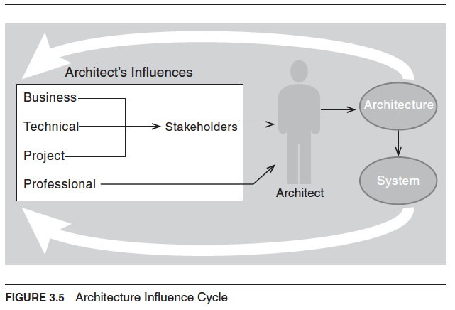
Architecture Influence Cycle
© Len Bass, Paul Clements, Rick Kazman, distributed under Creative Commons Attribution License
Notes:
Virtuous Cycle vs Vicious Cycle

Slide 5
Intricate Interactive Waltz of
Influence and Counterinfluence
Architects must identify and actively engage the stakeholders to solicit their needs and expectations
A software architect must have considerable communication, collaboration, and negotiating skills
  In addition to comprehensive technical and domain knowledge
  Technically AND politically correct
“90% social sciences and diplomacy, 10% technology!”

Slide 6
The Architecture Milieu of Influences
Project
Business Context
Schedule and budget
Functional requirements
Architecturally significant requirements
Goals
Constraints
Project Context
What life cycle
E.g., iterative or agile
Stakeholders:
  Users
  Managers
  Investors
  Marketing
  Customers
  Support
  Developers
Software Architecture
Technology
Technology Context
Constraints
Legacy systems
External systems
Platforms
Standards
Innovation
Professional Context
Experience
Knowledge
Bias
Architects

Slide 7
The Architecture Milieu of Influences
Project
Business Context
New business opportunities
  Requirements for next systems
  Economies for support and development
Project Context
Prescribe development structure
  Change engineering culture
  Technical development environment
Stakeholders:
  Users
  Managers
  Investors
  Marketing
  Customers
  Support
  Developers
Software Architecture
Technology
Technology Context
  Requirements for future systems
  Opportunities for integrating new technologies, innovation
Professional Context
  Architect’s experience and knowledge – what works, what doesn’t
Architects

Slide 8
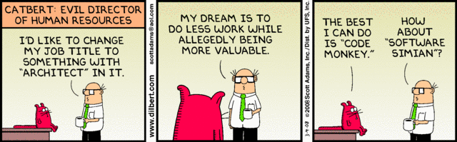
What is the Role of a Software Architect?

Slide 9
Architecture in the Product Life-Cycle
Inception
Elaboration
Construction
Transition
Upgrade
Envision
Create
and
Analyze
Architecture
System
Reuse
Other
Products
Inception
Architectural Baseline
Inception
Architect’s Role
Highest
Lower

Slide 10
Architect’s Responsibilities
Contribute to the business case for the system
Understand the architecturally significant requirements
Design or select the architecture
Document, communicate, and represent the architecture
Analyze or evaluate the architecture
Oversee/contribute to system construction based on the architecture
Ensure the implementation conforms to the architecture - validate

Slide 11
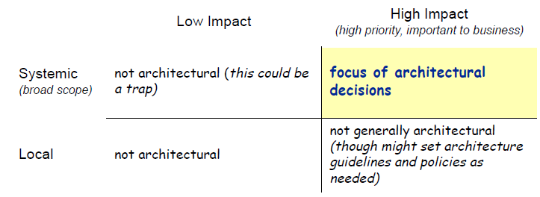
Architecture Decision Scope and Impact

Slide 12
Software Architect Role Profile
Architecture design but also …
System software and hardware selection
Build vs. buy decisions
Architecturally significant requirements
Development methodology, process, standards
Technical and project leadership
Coaching
Hands on construction
Leverage experience, track technology trends

Slide 13
Software Architect Role
(Job Description)
The software architect creates a vision
  Keeps up with innovations and technologies
  Understands global requirements and constraints (business and technical)
  Creates a vision (global view) of the system
  Communicates the vision effectively
  Provides requirements and inputs to the system architect (if separate role)
The software architect is the key technical consultant
  Organizes the development team around the architecture design
  Manages dependencies
  Reviews and negotiates requirements
  Assesses technical capabilities of staff
  Motivates the team
  Recommends technology, training, tools
  Tracks the quality of the design
  Ensures architecture meets its design goals
(from Hofmeister et al., Applied Software Architecture)

Slide 14
Software Architect Role (continued)
The software architect makes decisions
  Leads the design team
  Makes early design decisions (key global ones)
  Knows when to end discussion and make a decision
  Identifies and manages risk
The software architect coaches
  Establishes dialog with each team member
  Teaches the team the architecture design and gets their buy-in
  Listens to feedback
  Knows when to yield to design changes
  Knows when to let others take over detailed design
The software architect coordinates
  Coordinates activities of tasks that influence or are influenced by the architecture
  Maintains integrity of the design
  Ensures that the architecture is followed

Slide 15
Software Architect Role (continued)
The software architect implements
  Considers the design implications of introducing a new technology
  May look at low-level details to validate initial concepts
  May prototype to explore and evaluate design decisions
  May implement a thin vertical slice to minimize implementation risk
  May implement components as an implementation model for developers
The software architect advocates
  Advocates investment in software architecture
  Works to incorporate software architecture into the software process
  Continues to assess and advocate new software architecture technologies
  Advocates architecture reuse

Slide 16
Career Path
Set your sights on becoming an expert in software engineering
  gather broad experience
  develop technical, leadership, communication and people skills
Apprentice (hang out) with an experienced architect, or better get an architect mentor
Senior
Software
Engineer
Software
Engineer
Individual
Contributor
Team
Leader
Architect
Increasing responsibility, scope and challenge
(from Hofmeister et al., Applied Software Architecture)

